Slide 1
Ricardo Gonzalo Alex Sánchez
ricardo.gonzalo@vhir.org alex.sanchez@vhir.org
High Throughput Data Analysis. Microarrays Biological Significance

Slide 2


Table of contents
Introduction to microarrays technology (expression Arrays)
Microarray Data Analysis
Introduction to Biological Significance
Example of a microarray analysis with R

Slide 3
Table of contents
Introduction to microarrays technology (expression Arrays)
Microarray Data Analysis
Introduction to Biological Significance
Example of a microarray analysis with R

Slide 4
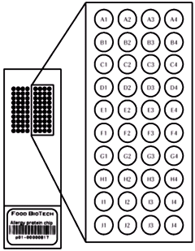
A microarray (of nucleic acids) in few words?
DNA fixed to a solid surface (nylon, silica, glass,...)
is called probe
RNA “problem” is labelled, and have to bind to DNA fixed in the solid surface in an specific way.
is called target

Slide 5
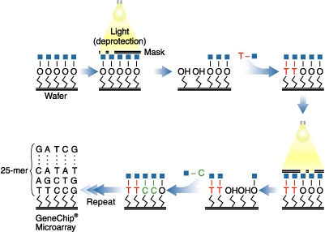
Introduction to microarrays technology
Photolitografy

Slide 6

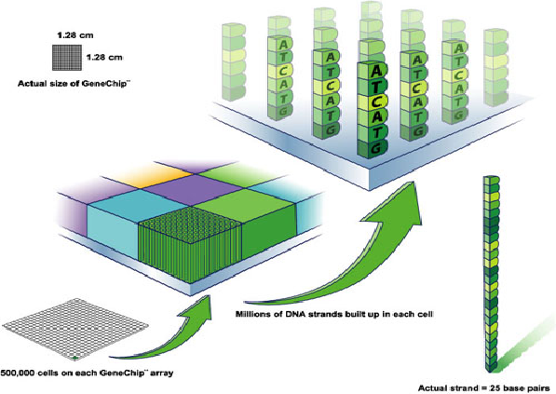
Introduction to microarrays technology

Slide 7
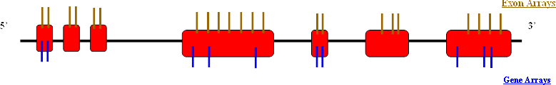
Introduction to microarrays technology
5’
3’
3’IVT
Exon
Gene
Clariom S
3’
5’
HTA
Clariom D
Non codingRNA

Slide 8
Introduction to microarrays technology
3’ IVT ARRAYS
Cost increase with the amount of information analyzed in the array
GENE/EXON ARRAYS
Updated information
HUMAN TRANSCRIPTOME ARRAYS
CLARIOM ARRAYS

Slide 9
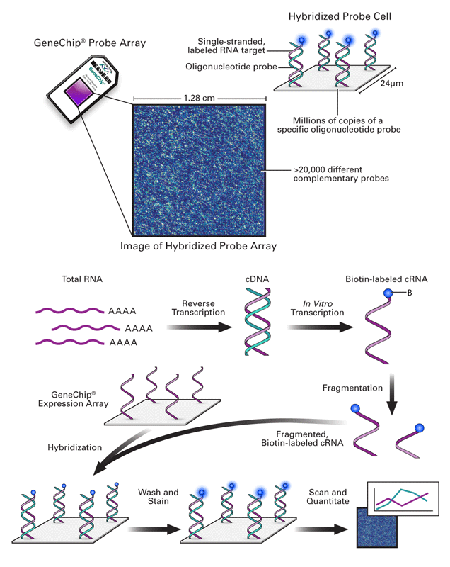
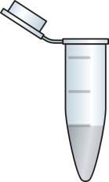
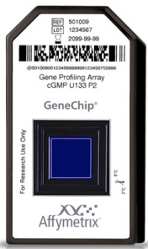
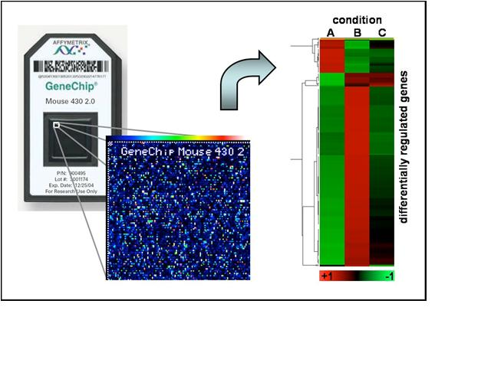
Introduction to microarrays technology
A
B
C
One sample
hybridized per array
The sample is stained with one dye
(absolute fluorescence measure)

Slide 10

Introduction to microarrays technology

Slide 11

Introduction to microarrays technology
“CEL” FILES

Slide 12
Table of contents
Introduction to microarrays technology (expression Arrays)
Microarray Data Analysis
Introduction to Biological Significance
Example of a microarray analysis with R

Slide 13
BIOLOGICAL QUESTION
EXPERIMENTAL DESIGN
MICROARRAY EXPERIMENT
QUALITY CONTROL
NORMALIZATION
ANALYSIS
FILTERING
ESTIMATION
TESTING
CLUSTERING
BIOLOGICAL VERIFICATION AND INTERPRETATION

Slide 14
BIOLOGICAL QUESTION
EXPERIMENTAL DESIGN
MICROARRAY EXPERIMENT
QUALITY CONTROL
NORMALIZATION
ANALYSIS
FILTERING
ESTIMATION
TESTING
CLUSTERING
BIOLOGICAL VERIFICATION AND INTERPRETATION

Slide 15
Microarray data analysis with R. QUALITY CONTROL OF THE DATA
First of all we have to decide if the data are good to work with.
Microarray experiments generate huge quantities of data
Standard statistical approach use plots to check the quality
show all data together
highlight structures
may help to detect problems (“unusual patterns”)
It is hard to decide if things “seem to be all right” just by looking at the numbers.

Slide 16
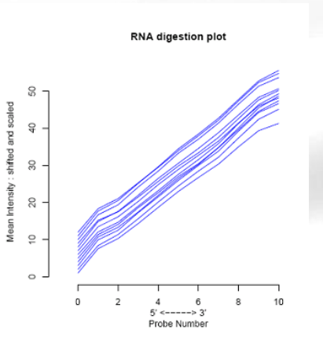
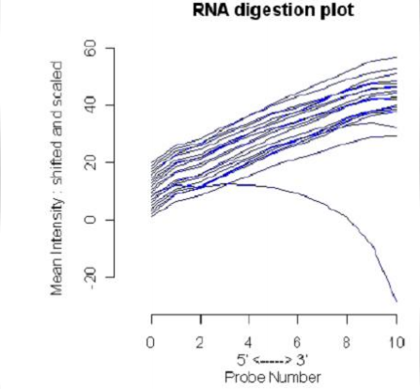
Microarray data analysis with R. QUALITY CONTROL OF THE DATA
RNA digestion plot. Only for 3’Arrays.

Slide 17
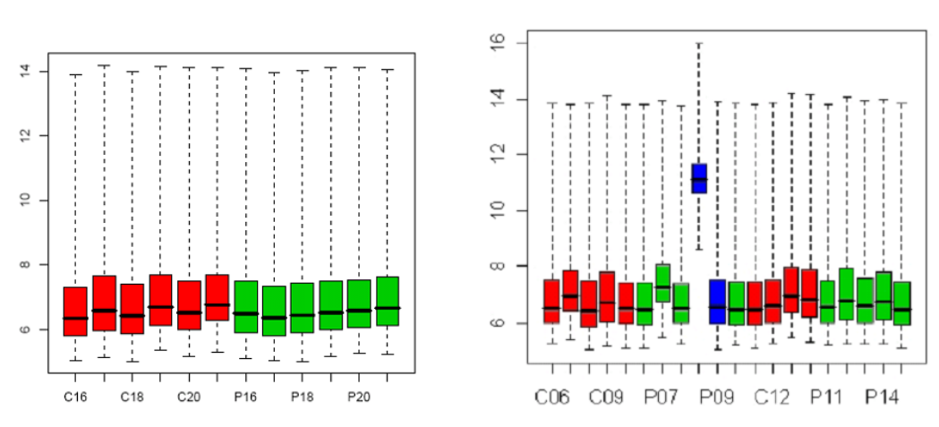
Microarray data analysis with R. QUALITY CONTROL OF THE DATA
Boxplot intensities. Raw data/Normalized data

Slide 18
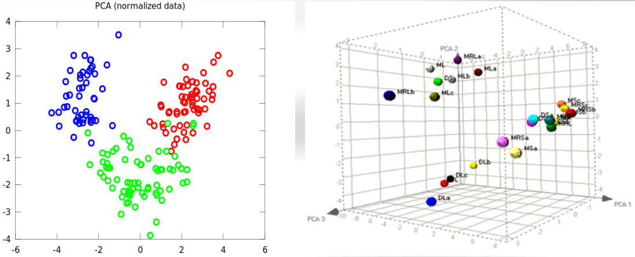
Example of a microarray analysis with R. QUALITY CONTROL OF THE DATA
Principal Component Analysis. Raw data/Normalized data

Slide 19
BIOLOGICAL QUESTION
EXPERIMENTAL DESIGN
MICROARRAY EXPERIMENT
QUALITY CONTROL
NORMALIZATION
ANALYSIS
FILTERING
ESTIMATION
TESTING
CLUSTERING
BIOLOGICAL VERIFICATION AND INTERPRETATION

Slide 20
Microarray data analysis with R. DATA NORMALIZATION
It is very important (essential) to normalize your data.
Why normalization?
To remove systematic biases:
Sample preparation
Variability in hybridization
Scanner settings
Experimenter bias
To achieve a measured scale such that:
Has the same origin for all spots
Linear relationship with mRNA quantity

Slide 21
Microarray data analysis with R. DATA NORMALIZATION
There exist different methods:
RMA (Robust Multiarray Average): Performs background correction, normalization, and summarization in a modular way. RMA does not take in account unspecific probe hybridization in probe set background calculation (Irizarry et al., 2003)
GCRMA: is a version of RMA with a background correction component that makes use of a probe sequence information (Wu et al., 2004)
PLIER (Probe logarithmic error intensity estimate): this method produces an improved signal by accounting for experimentally observed patterns in probe behavior and handling error at the appropriately low and high signal values
Notes:
Targets file normalmente csv. Lo haríamos con un excel o libre office, etc y se grabaría en csv
Cel files en una carpeta determinada

Slide 22
Example of a microarray analysis with R. DATA NORMALIZATION
Nevertheless the steps they perform are common.
General steps:
Background correction: correction of the scale origin for spots
Normalization: standardizing the scale unit. Intensity calculation
Summary of information of several spots into a single measure for each gene
Notes:
Targets file normalmente csv. Lo haríamos con un excel o libre office, etc y se grabaría en csv
Cel files en una carpeta determinada

Slide 23
BIOLOGICAL QUESTION
EXPERIMENTAL DESIGN
MICROARRAY EXPERIMENT
QUALITY CONTROL
NORMALIZATION
ANALYSIS
FILTERING
ESTIMATION
TESTING
CLUSTERING
BIOLOGICAL VERIFICATION AND INTERPRETATION

Slide 24

Microarray data analysis with R. DATA FILTERING
In a microarray experiment only a few hundreds/thousand of genes change their expression due to the different conditions
Researcher is interested in keeping the number of tests/genes as low as possible while keeping the interesting genes in the selected subset.
Genes that do not change introduce noise, therefore is better not to be present when the statistical analysis is done
Notes:
Targets file normalmente csv. Lo haríamos con un excel o libre office, etc y se grabaría en csv
Cel files en una carpeta determinada

Slide 25
Microarray data analysis with R. DATA FILTERING
There exist different types of filtering:
Annotation features (specific):
Specific gene features (i.e. GO term, presence of transcriptional regulative elements in promoters, etc.)
Signal features (non specific)
% intensities greater of a user defined value
Interquartile range (IQR) greater of a defined value
Variance between samples (non specific)
Genes that do not change among conditions, could be excluded
Notes:
Targets file normalmente csv. Lo haríamos con un excel o libre office, etc y se grabaría en csv
Cel files en una carpeta determinada

Slide 26
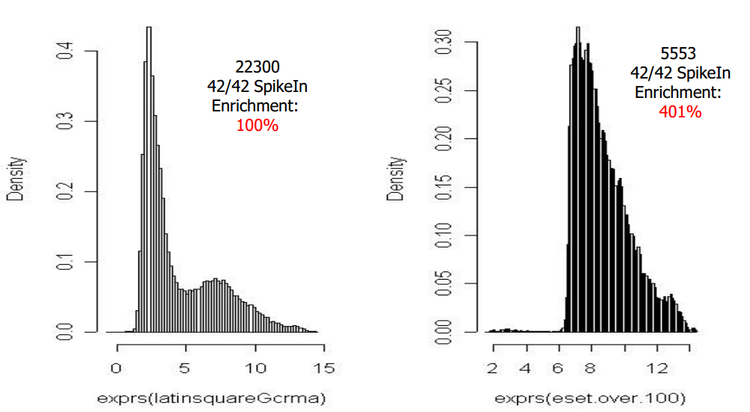
Microarray data analysis with R. DATA FILTERING
Signal filtering: This technique has as its premise the removal of genes that are deemed to be not expressed or unchanged according to some specific criterion that is under the control of the user.
Notes:
Targets file normalmente csv. Lo haríamos con un excel o libre office, etc y se grabaría en csv
Cel files en una carpeta determinada

Slide 27
Microarray data analysis with R. COMPARISONS
Statistical inference of differential expression
Class comparison problem:
Identify genes whose expression is significantly associated with different conditions:
Treatment, cell type …
Dose, time,….
Estimate effects/differences between groups.
Notes:
Targets file normalmente csv. Lo haríamos con un excel o libre office, etc y se grabaría en csv
Cel files en una carpeta determinada

Slide 28
Microarray data analysis with R. COMPARISONS
Which situations does one usually see (here the easiest)?
Indirect comparisons: 2 groups, unpaired
E.g. 10 individuals: 5 suffer diabetes, 5 healthy
One sample from each individual
Test: Two sample t-test
Direct comparisons: 2 groups, paired
E.g. 10 individuals with brain stroke
Two samples from each patient: one from healthy region1 and one from affected region
Test: Paired t-test
Notes:
Targets file normalmente csv. Lo haríamos con un excel o libre office, etc y se grabaría en csv
Cel files en una carpeta determinada

Slide 29
Microarray data analysis with R. COMPARISONS
Some issues in gene selection
Some related with small sample sizes
Variance instability (very low variances produces a high t statistic value)
Non-normality of the data
Related to the big number of variables (test to perform)
Multiple testing problem
Standard t test is not strictly correct to be used here, better to use a “modified version”: moderated t test
Notes:
Targets file normalmente csv. Lo haríamos con un excel o libre office, etc y se grabaría en csv
Cel files en una carpeta determinada

Slide 30
Microarray data analysis with R. COMPARISONS
Multiple testing problem: It is needed to control for the type I error (false positives). FALSE DISCOVERY RATE
Finally we will be assigning a p-value for each test/gene. If the p-value is lower than an established threshold….
Notes:
Targets file normalmente csv. Lo haríamos con un excel o libre office, etc y se grabaría en csv
Cel files en una carpeta determinada

Slide 31
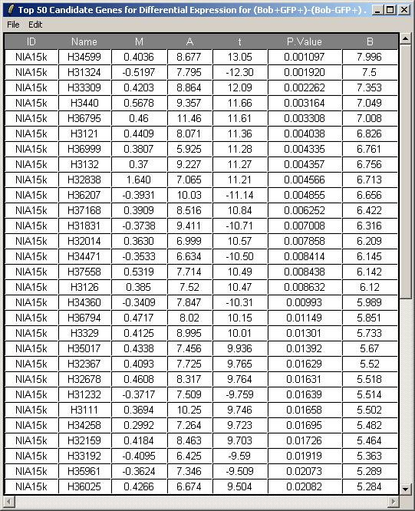
Microarray data analysis with R. Results presentation. TOP TABLES
1
2
3
4
5
6
Gene identifiers
Log2 Fold Change
Average intensity
t statistics
p-values
Log-odd statistics
1
2
3
4
5
6
Notes:
Targets file normalmente csv. Lo haríamos con un excel o libre office, etc y se grabaría en csv
Cel files en una carpeta determinada

Slide 32
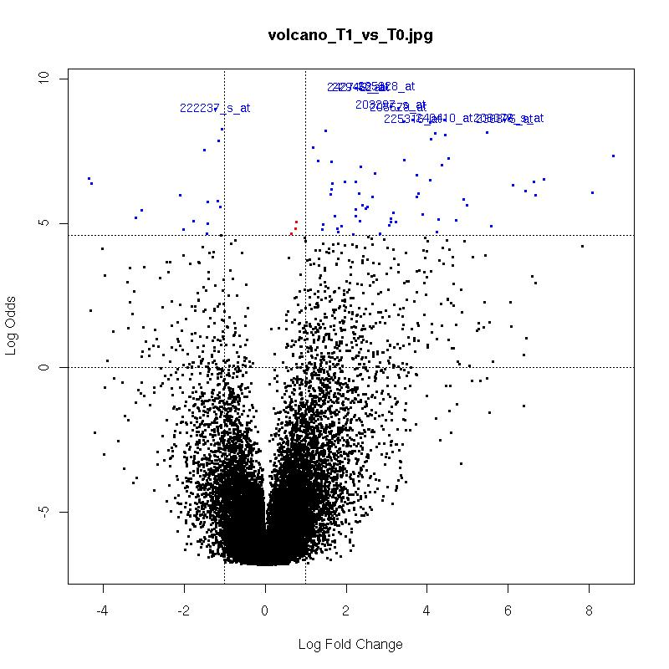
Microarray data analysis with R. Results presentation. VOLCANO PLOTS
Statistics and biological significance representation
Notes:
Targets file normalmente csv. Lo haríamos con un excel o libre office, etc y se grabaría en csv
Cel files en una carpeta determinada

Slide 33
Example of a microarray analysis with R. Results presentation. CLUSTERING
Types:
Supervised clustering try to find the best partition for data that belong to a know set o classes
Unsupervised clustering try to define the number and the size of the classes in which the transcription profiles can be fitted in.
Distances between genes/samples are used to classify them (Euclidian distance, Manhattan distance, Mahalanovis distance….)
Notes:
Targets file normalmente csv. Lo haríamos con un excel o libre office, etc y se grabaría en csv
Cel files en una carpeta determinada

Slide 34
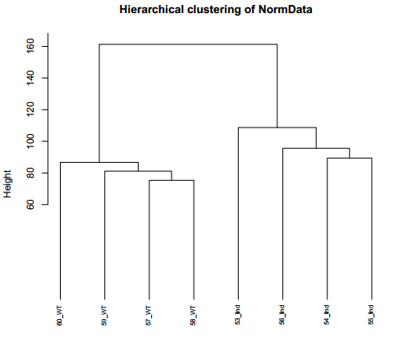
Example of a microarray analysis with R. Results presentation. CLUSTERING
Hierarchical Clustering (HCL)
HCL is an agglomerative /dividing clustering method.
The iterative process continues until all groups are connected in a hierarchical tree.
Samples more similar between them are closed.
Notes:
Targets file normalmente csv. Lo haríamos con un excel o libre office, etc y se grabaría en csv
Cel files en una carpeta determinada

Slide 35
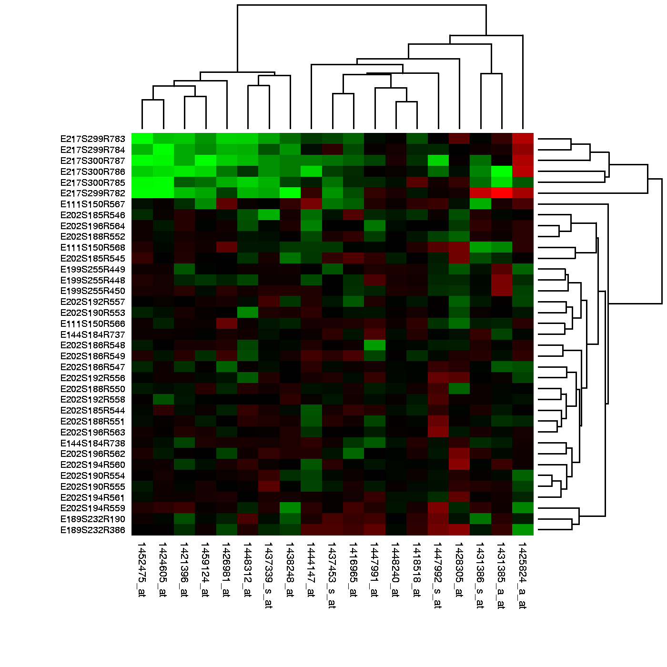
Microarray data analysis with R. Results presentation. CLUSTERING
Heatmaps
Allow a quick visualization of the possible expression patterns that could exists among samples.
Notes:
Targets file normalmente csv. Lo haríamos con un excel o libre office, etc y se grabaría en csv
Cel files en una carpeta determinada

Slide 36
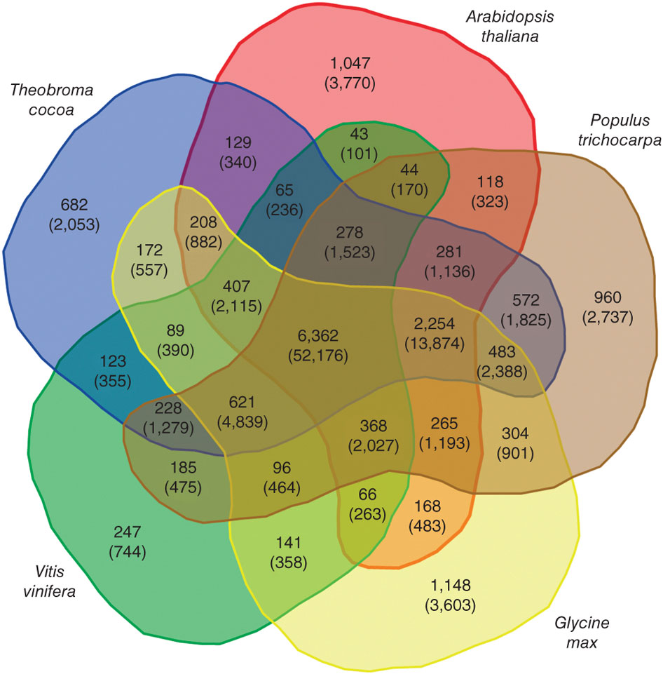
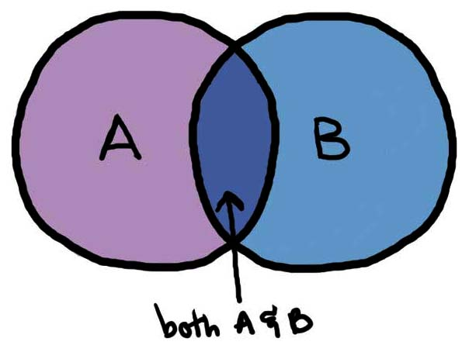
Microarray data analysis with R. Results presentation. VENN DIAGRAMS
If the study have more than one comparisons it could be interesting to look for common genes in the gene lists (multiple comparisons)
Notes:
Targets file normalmente csv. Lo haríamos con un excel o libre office, etc y se grabaría en csv
Cel files en una carpeta determinada

Slide 37
Microarray data analysis with R. Results presentation. ANNOTATION
Relation between probes sets and genes.
An important issue in microarray data analysis is the specific association of probe identifiers with genome annotated transcripts.
Not of the probes have a “genome annotated transcript”.
Different database used (Entrez, Gene Symbol, Ensembl,…) generates different results.
Notes:
Targets file normalmente csv. Lo haríamos con un excel o libre office, etc y se grabaría en csv
Cel files en una carpeta determinada

Slide 38
Table of contents
Introduction to microarrays technology (expression Arrays)
Microarray Data Analysis
Introduction to Biological Significance
Example of a microarray analysis with R

Slide 39
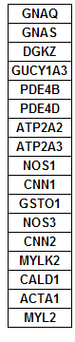
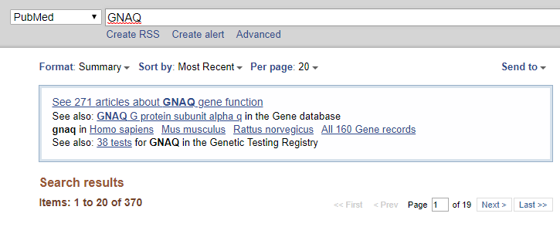




Introduction to Biological Significance
You obtained a list of features!!!! … what is next?
Select some genes for validation?
Follow up experiments on some genes?
Publish a huge table with all results?
Try to learn on all genes in the list?
my favourite gene

Slide 40
Introduction to Biological Significance
From gene lists to Pathway Analysis
Gene lists contain useful information
This can be extracted from databases
Generically described as Gene Annotation
Besides, we may obtain information from the analysis of gene sets
Genes don’t act individually, rather in group (more realistic approach)
There are less gene sets tan individual genes (relatively simpler to manage)
Generically described as Pathway analysis

Slide 41
Introduction to Biological Significance
What do we need?
A way to identify genes relevant to the condition under study
A shared functional vocabulary
Systematic link between genes and functions
Statistical analysis

Slide 42
Introduction to Biological Significance
What do we need?
A way to identify genes relevant to the condition under study
A shared functional vocabulary
Systematic link between genes and functions
Statistical analysis
Fold change, ranking, ANOVA
Gene Ontology
Annotation
Enrichment analysis, GSEA

Slide 43
Introduction to Biological Significance
Gene list and Annotations
Identifiers (Ids) are ideally unique, stable names or numbers that help track database records (e.g. social insurance number, Entrez gene ID)
But, information of features is stored in many databases
Genes have many Ids
Records for: Gene, DNA, RNA, Protein

Slide 44
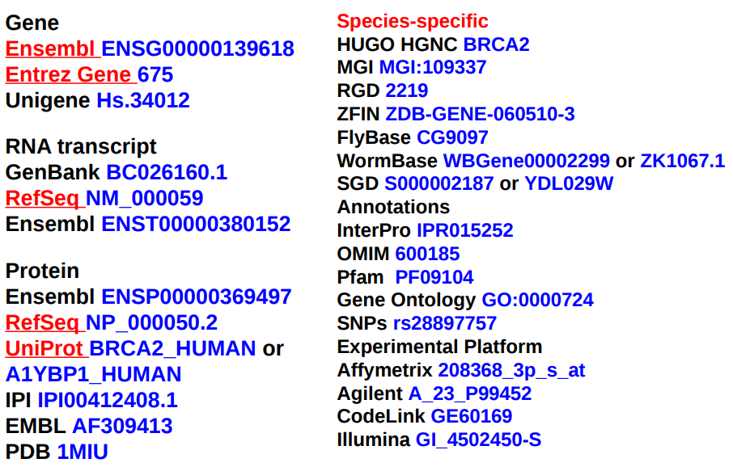
Introduction to Biological Significance
Common identifiers
In Red = recommended

Slide 45
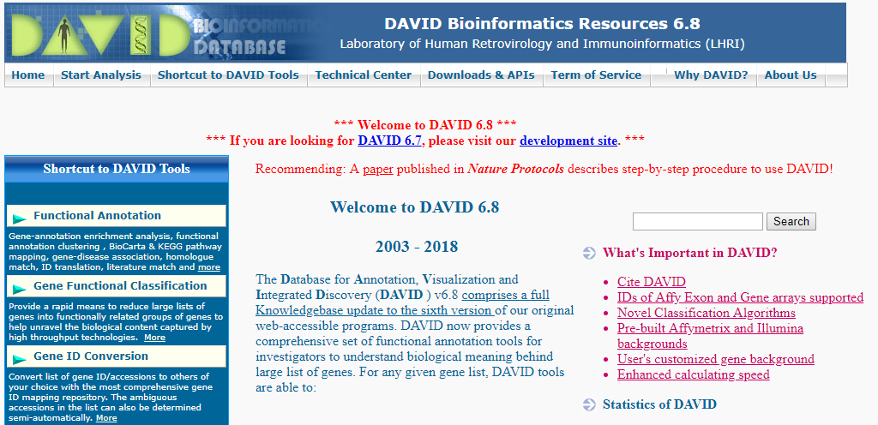
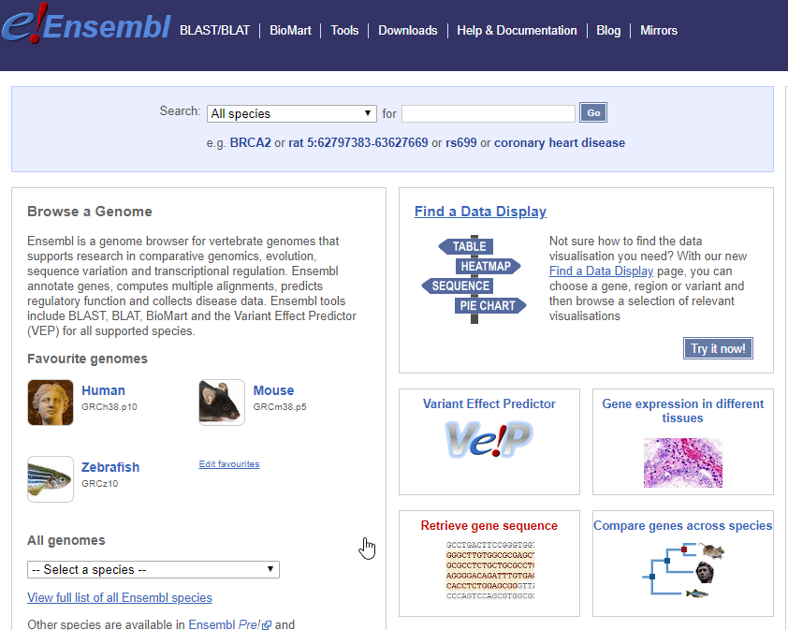
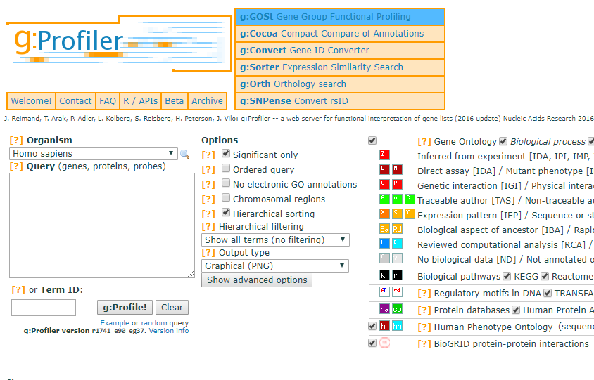
Introduction to Biological Significance
Use ID converters to prepare lists:

Slide 46

Introduction to Biological Significance
GENE ONTOLOGY (http://www.geneontology.org/)
A major bioinformatics initiative with the aim of standardizing the representation of gene and gene product attributes across species and databases.
The Gene Ontology (GO) is a controlled vocabulary, a set of standard terms (words and phrases) used for indexing and retrieving information.

Slide 47
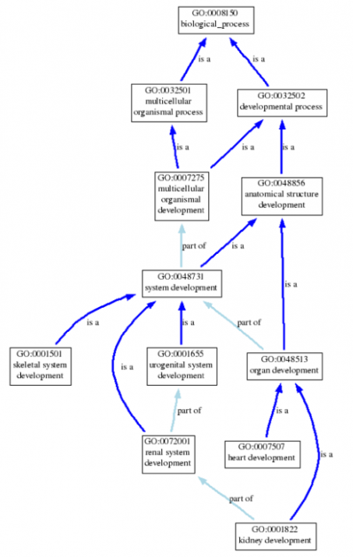
Introduction to Biological Significance
GENE ONTOLOGY STRUCTURE
GO defines the relationships between the terms, making it a structured vocabulary.
Terms are related within a hierarchy (“is a”, “is part of”)
Terms can have more than one parent or child

Slide 48
Introduction to Biological Significance
GENE ONTOLOGY DOMAINS
MOLECULAR FUNCTION (MF): basic activity or task
e.g. catalytic activity, calciom ion binding
BIOLOGICAL PROCESS (BP): broad objective or goal
e.g. signal transduction, inmuno response
CELLULAR COMPONENT (CC): Location or complex
e.g. nucleus, mitochondrion
Cytochrome c: MF = oxidoreductase activity
BP = oxidative phosphorilation and induction of cell death
CC = mitochondrial matrix and mitochondrial inner membrane

Slide 49
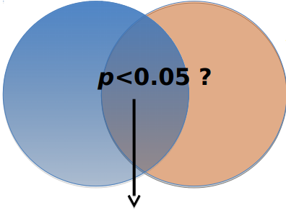
Introduction to Biological Significance
Enrichment Analysis
Hypothesis: Drug sensitivity in brain cancer is related to reduced neurotransmitter signaling
Gene list from the experiment
All the genes known to be involved in Neurotransmitter signaling
Statistical test : are there more annotations in gene list than expected?

Slide 50
Introduction to Biological Significance
Gene list (e.g. expression change > 2-fold)
Answer the question: Are any gene set surprisingly enriched or (depleted) in my gene list?
Statistical test: Fisher’s Exact test (hypergeometric test)
Ranked list (e.g. by differential expression)
Answer the question: Are any gene set ranked surprisingly high or low in my ranked list of genes?
Statistical test: mininum hypergeometric test

Slide 51
Introduction to Biological Significance
Hypergeometric test
Microarray
Experiment
(gene expression table)
Gene list
(e.g UP-regulated)
Background
(all genes on the array)

Slide 52
Introduction to Biological Significance
Hypergeometric test
Microarray
Experiment
(gene expression table)
Gene list
(e.g UP-regulated)
Gene-set
Background
(all genes on the array)

Slide 53
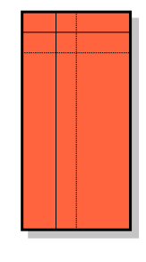

Introduction to Biological Significance
Hypergeometric test
Random samples of array genes (quite probable to get by chance)
The output of an enrichment test is a P-value
The P-value assesses the probability that the overlap is at least as large as observed by random sampling
the array genes.
Overlap very improbable to get by chance

Slide 54
Introduction to Biological Significance
Recipe for gene list enrichment test:
Define gene list (e.g. FC >3) and background list (e.g. all genes in the array)
Select gene sets to test for enrichment
Run enrichment test and adjust for multiple testing if necessary
Interpret your enrichments

Slide 55
Table of contents
Introduction to microarrays technology (expression Arrays)
Microarray Data Analysis
Introduction to Biological Significance
Example of a microarray analysis with R

Slide 56

Example of a microarray analysis with R. LOAD THE DATA
GENE EXPRESSION ONMIBUS DATABASE
Public functional genomic repository from NCBI
Array and sequence-based data are accepted
It is mandatory to upload your microarrays CEL files before publishing any article about them
http://www.ncbi.nlm.nih.gov/geo/

Slide 57

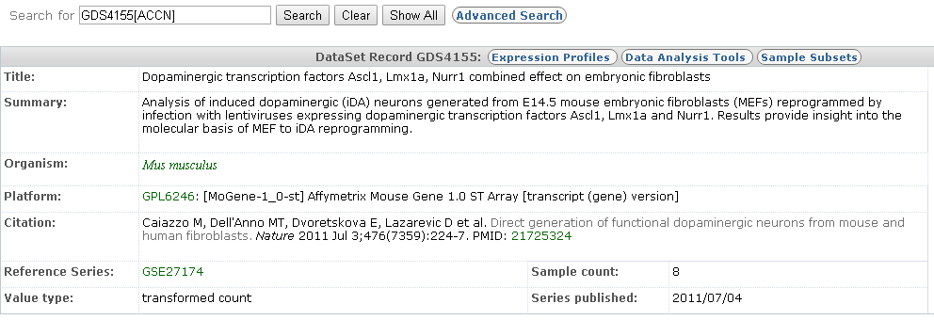
Example of a microarray analysis with R. LOAD THE DATA
GENE EXPRESSION ONMIBUS DATABASE
The data for the example: GDS4155

Slide 58
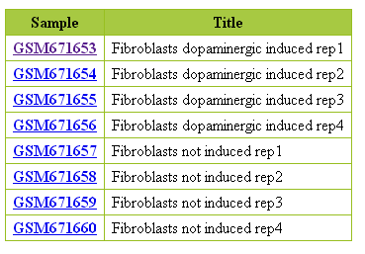
Example of a microarray analysis with R. LOAD THE DATA
INDUCED
WT

Slide 59
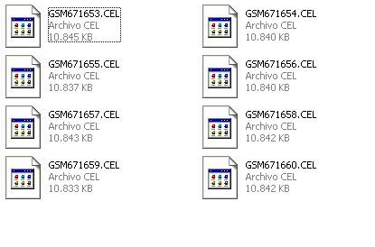
Example of a microarray analysis with R. LOAD THE DATA
Two types of files are necessary to begin the data analysis:
CEL files
Targets file
fileName | grupos | ShortName | Colors
GSM671653.CEL | Induced | 53_Ind | red
GSM671654.CEL | Induced | 54_Ind | red
GSM671655.CEL | Induced | 55_Ind | red
GSM671656.CEL | Induced | 56_Ind | red
GSM671657.CEL | WT | 57_WT | blue
GSM671658.CEL | WT | 58_WT | blue
GSM671659.CEL | WT | 59_WT | blue
GSM671660.CEL | WT | 60_WT | blue
Notes:
Targets file normalmente csv. Lo haríamos con un excel o libre office, etc y se grabaría en csv
Cel files en una carpeta determinada

Slide 60
Example of a microarray analysis with R. LOAD THE DATA
We have to define the folders before begin to analyze
make a folder name it for exemple “microarrays”
inside this folder create two more:
name the second “dades”
name the second “results”
save the CEL and target files in the “dades” folder
open “MA-Analysis-Example.R” with RStudio
Notes:
Targets file normalmente csv. Lo haríamos con un excel o libre office, etc y se grabaría en csv
Cel files en una carpeta determinada

Slide 61
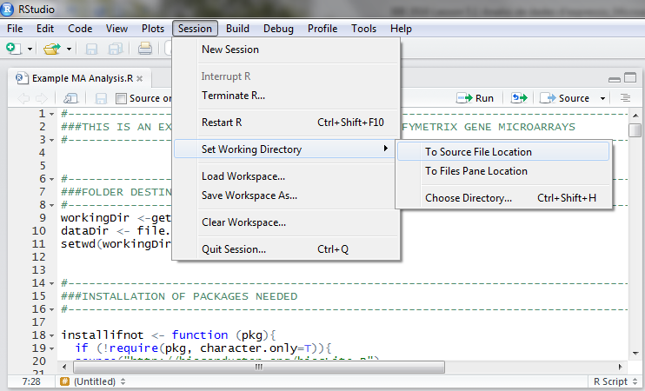
Example of a microarray analysis with R. LOAD THE DATA
Notes:
Targets file normalmente csv. Lo haríamos con un excel o libre office, etc y se grabaría en csv
Cel files en una carpeta determinada

Slide 62
Example of a microarray analysis with R. LOAD THE DATA
We have to define the working folders:
workingDir <- getwd()
dataDir <- file.path(workingDir, "data")
dataDir
resultsDir <- file.path(workingDir, "results")
resultsDir
Define the function to install the packages:
installifnot <- function (pkg){
if (!require(pkg, character.only=T)){
source("http://bioconductor.org/biocLite.R")
biocLite(pkg)
}else{
require(pkg, character.only=T)
}
}
Notes:
Targets file normalmente csv. Lo haríamos con un excel o libre office, etc y se grabaría en csv
Cel files en una carpeta determinada

Slide 63
Example of a microarray analysis with R. LOAD THE DATA
Install the necessary packages:
installifnot("pd.mogene.1.0.st.v1")
installifnot("mogene10sttranscriptcluster.db")
installifnot("oligo")
installifnot("limma")
installifnot("Biobase")
installifnot("arrayQualityMetrics")
installifnot("genefilter")
installifnot("multtest")
installifnot("annotate")
installifnot("xtable")
installifnot("gplots")
installifnot("scatterplot3d")
To be sure, all the packages are installed and loaded, execute last code twice.

Slide 64
Example of a microarray analysis with R. LOAD THE DATA
We load the data:
#-----------------------------------------------------------------------------------
###LOAD DATA: TARGETS AND CEL FILES.
#------------------------------------------------------------------------------------
#TARGETS
targets <-read.csv(file=file.path(dataDir,"targets.csv"), header = TRUE, sep=";")
targets
#CELFILES
CELfiles <- list.celfiles(file.path(dataDir))
CELfiles
rawData <- read.celfiles(file.path(dataDir,CELfiles))
#DEFINE SOME VARIABLES FOR PLOTS
sampleNames <- as.character(targets$ShortName)
sampleColor <- as.character(targets$Colors)
Notes:
Targets file normalmente csv. Lo haríamos con un excel o libre office, etc y se grabaría en csv
Cel files en una carpeta determinada

Slide 65
Example of a microarray analysis with R. QUALITY CONTROL OF THE DATA
Let’s do with our data:
#-----------------------------------------------------------------------------
###QUALITY CONTROL OF ARRAYS: RAW DATA
#-----------------------------------------------------------------------------
#BOXPLOT
boxplot(rawData, which="all",las=2, main="Intensity distribution of RAW data",
cex.axis=0.6, col=sampleColor, names=sampleNames)
#HIERARQUICAL CLUSTERING
clust.euclid.average <- hclust(dist(t(exprs(rawData))),method="average")
plot(clust.euclid.average, labels=sampleNames, main="Hierarchical clustering of RawData",
cex=0.7, hang=-1)

Slide 66
Example of a microarray analysis with R. QUALITY CONTROL OF THE DATA
Let’s do with our data:
#PRINCIPAL COMPONENT ANALYSIS
plotPCA <- function ( X, labels=NULL, colors=NULL, dataDesc="", scale=FALSE, formapunts=NULL, myCex=0.8,...)
{
pcX<-prcomp(t(X), scale=scale) # o prcomp(t(X))
loads<- round(pcX$sdev^2/sum(pcX$sdev^2)*100,1)
xlab<-c(paste("PC1",loads[1],"%"))
ylab<-c(paste("PC2",loads[2],"%"))
if (is.null(colors)) colors=1
plot(pcX$x[,1:2],xlab=xlab,ylab=ylab, col=colors, pch=formapunts,
xlim=c(min(pcX$x[,1])-100000, max(pcX$x[,1])+100000),ylim=c(min(pcX$x[,2])-100000, max(pcX$x[,2])+100000))
text(pcX$x[,1],pcX$x[,2], labels, pos=3, cex=myCex)
title(paste("Plot of first 2 PCs for expressions in", dataDesc, sep=" "), cex=0.8)
}

Slide 67
Example of a microarray analysis with R. QUALITY CONTROL OF THE DATA
Let’s do with our data:
#PRINCIPAL COMPONENT ANALYSIS
plotPCA(exprs(rawData), labels=sampleNames, dataDesc="raw data", colors=sampleColor,
formapunts=c(rep(16,4),rep(17,4)), myCex=0.6)
#-------------------------------------------------------------------------
#SAVE TO A FILE
pdf(file.path(resultsDir, "QCPlots_Raw.pdf"))
boxplot(rawData, which="all",las=2, main="Intensity distribution of RAW data",
cex.axis=0.6, col=sampleColor, names=sampleNames)
plot(clust.euclid.average, labels=sampleNames, main="Hierarchical clustering of samples of RawData",
cex=0.7, hang=-1)
plotPCA(exprs(rawData), labels=sampleNames, dataDesc="raw data", colors=sampleColor,
formapunts=c(rep(16,4),rep(17,4)), myCex=0.6)
dev.off()

Slide 68
Example of a microarray analysis with R. DATA NORMALIZATION
Let’s do with our data:
#-----------------------------------------------------------------------------###DATA NORMALIZATION
#-----------------------------------------------------------------------------
eset<-rma(rawData)
write.exprs(eset, file.path(resultsDir, "NormData.txt"))
## We can see data previous normalization
head(exprs(rawData))
dim(exprs(rawData))
## We can see data after normalization
head(exprs(normData))
dim(exprs(normData))
Notes:
Targets file normalmente csv. Lo haríamos con un excel o libre office, etc y se grabaría en csv
Cel files en una carpeta determinada

Slide 69
Example of a microarray analysis with R. QUALITY CONTROL. NORMALIZED DATA
Let’s do with our data:
#----------------------------------------------------------------------
###QUALITY CONTROL OF ARRAYS: NORMALIZED DATA
#----------------------------------------------------------------------
#BOXPLOT
boxplot(eset, las=2, main="Intensity distribution of Normalized data", cex.axis=0.6,
col=sampleColor, names=sampleNames)
#HIERARQUICAL CLUSTERING
clust.euclid.average <- hclust(dist(t(exprs(eset))),method="average")
plot(clust.euclid.average, labels=sampleNames, main="Hierarchical clustering of NormData",
cex=0.7, hang=-1)
Notes:
Targets file normalmente csv. Lo haríamos con un excel o libre office, etc y se grabaría en csv
Cel files en una carpeta determinada

Slide 70
Example of a microarray analysis with R. QUALITY CONTROL. NORMALIZED DATA
Let’s do with our data:
#PRINCIPAL COMPONENT ANALYSIS
plotPCA <- function ( X, labels=NULL, colors=NULL, dataDesc="", scale=FALSE, formapunts=NULL, myCex=0.8,...)
{
pcX<-prcomp(t(X), scale=scale) # o prcomp(t(X))
loads<- round(pcX$sdev^2/sum(pcX$sdev^2)*100,1)
xlab<-c(paste("PC1",loads[1],"%"))
ylab<-c(paste("PC2",loads[2],"%"))
if (is.null(colors)) colors=1
plot(pcX$x[,1:2],xlab=xlab,ylab=ylab, col=colors, pch=formapunts,
xlim=c(min(pcX$x[,1])-10, max(pcX$x[,1])+10),ylim=c(min(pcX$x[,2])-10, max(pcX$x[,2])+10))
text(pcX$x[,1],pcX$x[,2], labels, pos=3, cex=myCex)
title(paste("Plot of first 2 PCs for expressions in", dataDesc, sep=" "), cex=0.8)
}
plotPCA(exprs(eset), labels=sampleNames, dataDesc="NormData", colors=sampleColor,
formapunts=c(rep(16,4),rep(17,4)), myCex=0.6)
Notes:
Targets file normalmente csv. Lo haríamos con un excel o libre office, etc y se grabaría en csv
Cel files en una carpeta determinada

Slide 71
Example of a microarray analysis with R. QUALITY CONTROL. NORMALIZED DATA
Let’s do with our data:
#SAVE TO A FILE
pdf(file.path(resultsDir, "QCPlots_Norm.pdf"))
boxplot(eset, las=2, main="Intensity distribution of Normalized data", cex.axis=0.6,
col=sampleColor, names=sampleNames)
plot(clust.euclid.average, labels=sampleNames, main="Hierarchical clustering of NormData",
cex=0.7, hang=-1)
plotPCA(exprs(eset), labels=sampleNames, dataDesc="selected samples", colors=sampleColor,
formapunts=c(rep(16,4),rep(17,4)), myCex=0.6)
dev.off()
#ARRAY QUALITY METRICS
arrayQualityMetrics(eset, reporttitle="QualityControl", force=TRUE)
Notes:
Targets file normalmente csv. Lo haríamos con un excel o libre office, etc y se grabaría en csv
Cel files en una carpeta determinada

Slide 72
Example of a microarray analysis with R. DATA FILTERING
Let’s do with our data:
#---------------------------------------------------------------------------
###FILTER OUT THE DATA
#---------------------------------------------------------------------------
annotation(eset) <- "org.Mm.eg.db“
eset_filtered <- nsFilter(eset, var.func=IQR, var.cutoff=0.75, var.filter=TRUE,
filterByQuantile=TRUE)
#NUMBER OF GENES OUT
print(eset_filtered$filter.log$numLowVar)
#NUMBER OF GENES IN
print(eset_filtered$eset)
Notes:
Targets file normalmente csv. Lo haríamos con un excel o libre office, etc y se grabaría en csv
Cel files en una carpeta determinada

Slide 73
Example of a microarray analysis with R. COMPARISONS
Let’s do with our data:
#---------------------------------------------------------------------------------------------
###DIFERENTIAL EXPRESSED GENES SELECTION. LINEAR MODELS. COMPARITIONS
#---------------------------------------------------------------------------------------------
#CONTRAST MATRIX.lINEAR MODEL
treat <- targets$grupos
lev <- factor(treat, levels = unique(treat))
design <-model.matrix(~0+lev)
colnames(design) <- levels(lev)
rownames(design) <- sampleNames
print(design)
#COMPARISON
cont.matrix1 <- makeContrasts(
Induced.vs.WT = Induced-WT,
levels = design)
comparison1 <- "Effect of Induction"
#MODEL FIT
fit1 <- lmFit(eset_filtered$eset, design)
fit.main1 <- contrasts.fit(fit1, cont.matrix1)
fit.main1 <- eBayes(fit.main1)
Notes:
Targets file normalmente csv. Lo haríamos con un excel o libre office, etc y se grabaría en csv
Cel files en una carpeta determinada

Slide 74
Example of a microarray analysis with R. Results presentation. TOP TABLES
Let’s do with our data:
#------------------------------------------------------------------------------------
###DIFERENTIAL EXPRESSED GENES LISTS.TOPTABLES
#------------------------------------------------------------------------------------
#FILTER BY FALSE DISCOVERY RATE AND FOLD CHANGE
topTab <- topTable (fit.main1, number=nrow(fit.main1), coef="Induced.vs.WT", adjust="fdr",lfc=abs(3))
#EXPORTED TO CSV AND HTML FILE
write.csv2(topTab, file= file.path(resultsDir,paste("Selected.Genes.in.comparison.",
comparison1, ".csv", sep = "")))
print(xtable(topTab,align="lllllll"),type="html",html.table.attributes="",
file=paste("Selected.Genes.in.comparison.",comparison1,".html", sep=""))
Notes:
Targets file normalmente csv. Lo haríamos con un excel o libre office, etc y se grabaría en csv
Cel files en una carpeta determinada

Slide 75
Example of a microarray analysis with R. Results presentation. VOLCANO PLOTS
Let’s do with our data:
#------------------------------------------------------------------------------------
###VOLCANO PLOTS
#------------------------------------------------------------------------------------
volcanoplot(fit.main1, highlight=10, names=fit.main1$ID,
main = paste("Differentially expressed genes", colnames(cont.matrix1), sep="\n"))
abline(v = c(-3, 3))
pdf(file.path(resultsDir,"Volcanos.pdf"))
volcanoplot(fit.main1, highlight = 10, names = fit.main1$ID,
main = paste("Differentially expressed genes", colnames(cont.matrix1), sep = "\n"))
abline(v = c(-3, 3))
dev.off()
Notes:
Targets file normalmente csv. Lo haríamos con un excel o libre office, etc y se grabaría en csv
Cel files en una carpeta determinada

Slide 76
Example of a microarray analysis with R. Results presentation. CLUSTERING
Let’s do with our data:
#---------------------------------------------------------------------------------------------
###HEATMAP PLOTS
#---------------------------------------------------------------------------------------------
#PREPARE THE DATA
my_frame <- data.frame(exprs(eset))
head(my_frame)
HMdata <- merge(my_frame, topTab, by.x = 0, by.y = 0)
rownames(HMdata) <- HMdata$Row.names
HMdata <- HMdata[, -c(1,10:15)]
head(HMdata)
HMdata2 <- data.matrix(HMdata, rownames.force=TRUE)
head(HMdata2)
write.csv2(HMdata2, file = file.path(resultsDir,"Data2HM.csv"))
#HEATMAP PLOT
my_palette <- colorRampPalette(c("blue", "red"))(n = 299)
heatmap.2(HMdata2,
Rowv=TRUE,
Colv=TRUE,
main="HeatMap Induced.vs.WT FC>=3",
scale="row",
col=my_palette,
sepcolor="white",
sepwidth=c(0.05,0.05),
cexRow=0.5,
cexCol=0.9,
key=TRUE,
keysize=1.5,
density.info="histogram",
ColSideColors=c(rep("red",4),rep("blue",4)),
tracecol=NULL,
srtCol=30)
Notes:
Targets file normalmente csv. Lo haríamos con un excel o libre office, etc y se grabaría en csv
Cel files en una carpeta determinada

Slide 77
Example of a microarray analysis with R. Results presentation. CLUSTERING
Let’s do with our data:
#EXPORT TO PDF FILE
pdf(file.path(resultsDir,"HeatMap InducedvsWT.pdf"))
heatmap.2(HMdata2,
Rowv=TRUE,
Colv=TRUE,
main="HeatMap Induced.vs.WT FC>=3",
scale="row",
col=my_palette,
sepcolor="white",
sepwidth=c(0.05,0.05),
cexRow=0.5,
cexCol=0.9,
key=TRUE,
keysize=1.5,
density.info="histogram",
ColSideColors=c(rep("red",4),rep("blue",4)),
tracecol=NULL,
srtCol=30)
dev.off()
Notes:
Targets file normalmente csv. Lo haríamos con un excel o libre office, etc y se grabaría en csv
Cel files en una carpeta determinada

Slide 78
Example of a microarray analysis with R. Results presentation. ANNOTATION
Let’s do with our data:
#---------------------------------------------------------------------------------------------
###DATA ANNOTATION
#---------------------------------------------------------------------------------------------
all_anota<-data.frame(exprs(eset))
Annot <- data.frame(SYMBOL=sapply(contents(mogene10sttranscriptclusterSYMBOL), paste, collapse=", "),
DESC=sapply(contents(mogene10sttranscriptclusterGENENAME), paste, collapse=", "))
Annot<-Annot[!Annot$SYMBOL=="NA",]
Annot<-Annot[!Annot$DESC=="NA",]
head(Annot)
anotaGenes <- merge(Annot,all_anota, by.x=0,by.y=0)
head(anotaGenes)
write.table(anotaGenes, file ="data.ann.txt",sep="\t")
rownames(anotaGenes) <- anotaGenes[,1]
anotaGenes <- anotaGenes[,-1]
anotaGenes.end <- merge(anotaGenes, topTab, by.x=0,by.y=0)
#reordenamos las columnas
topTab.end <- anotaGenes.end[,c(1:3,12:17,4:11)]
topTab.end <- topTab.end[order(-topTab.end$B),]
rownames(topTab.end) <- topTab.end[,1]
topTab.end <- topTab.end[, -1]
write.csv(topTab.end, file = file.path(resultsDir,"TopTable.end.csv"))
Notes:
Targets file normalmente csv. Lo haríamos con un excel o libre office, etc y se grabaría en csv
Cel files en una carpeta determinada

Slide 79
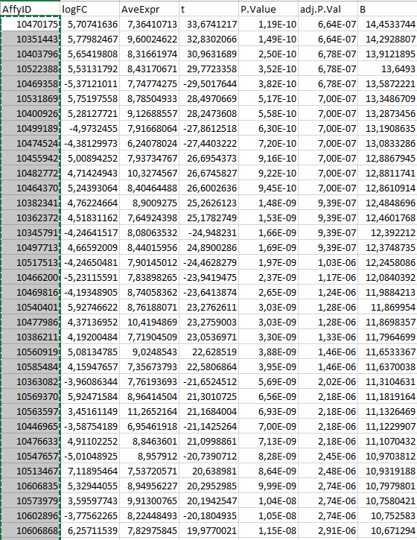
Introduction to Biological Significance
Our case study
Affy Ids that we may need to map to other (gene Ids, gene Symbols,…)

Slide 80

Introduction to Biological Significance
Our case study: List with genes fold change > 3
https://david.ncifcrf.gov/home.jsp

Slide 81
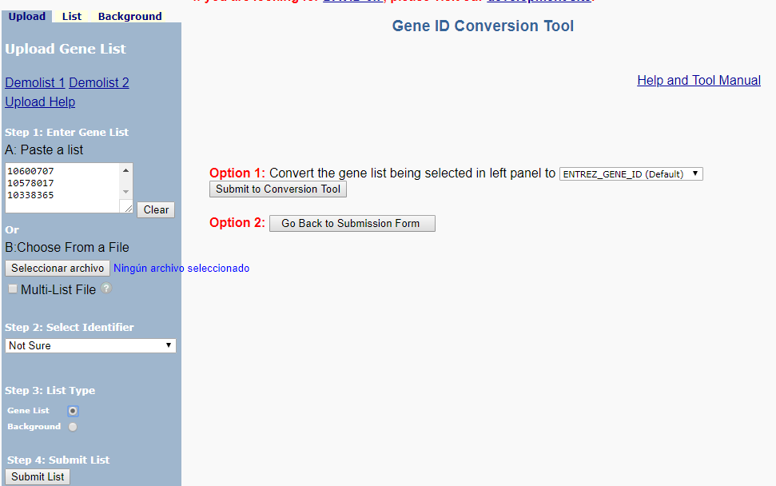
Introduction to Biological Significance

Slide 82
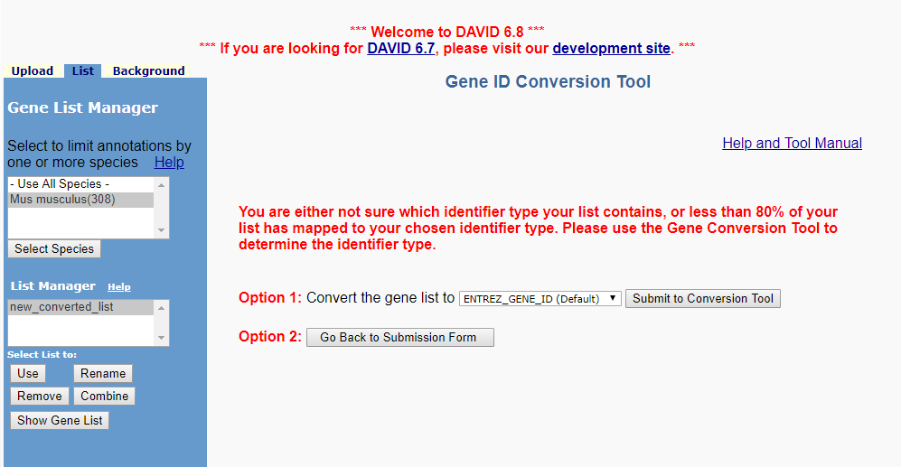
Introduction to Biological Significance

Slide 83
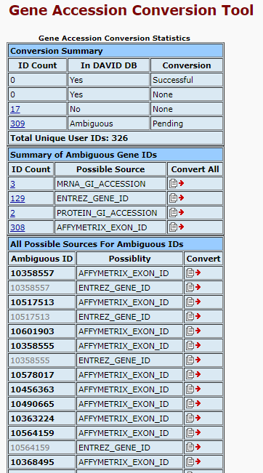
Introduction to Biological Significance

Slide 84
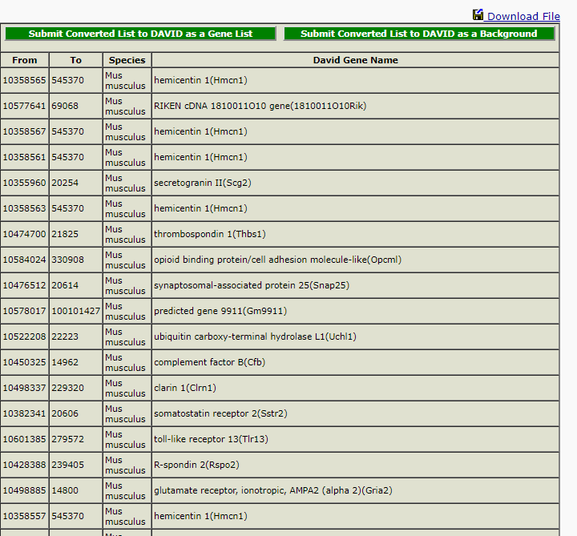
Introduction to Biological Significance

Slide 85
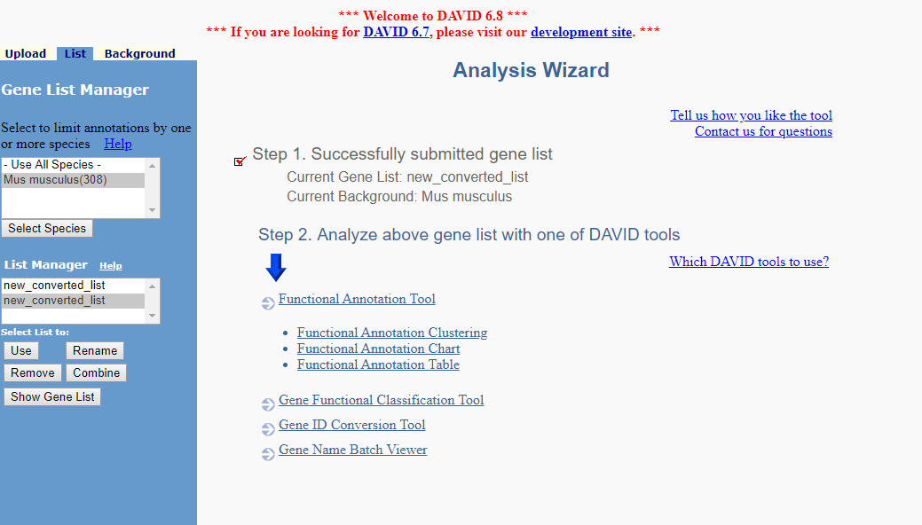
Introduction to Biological Significance

Slide 86
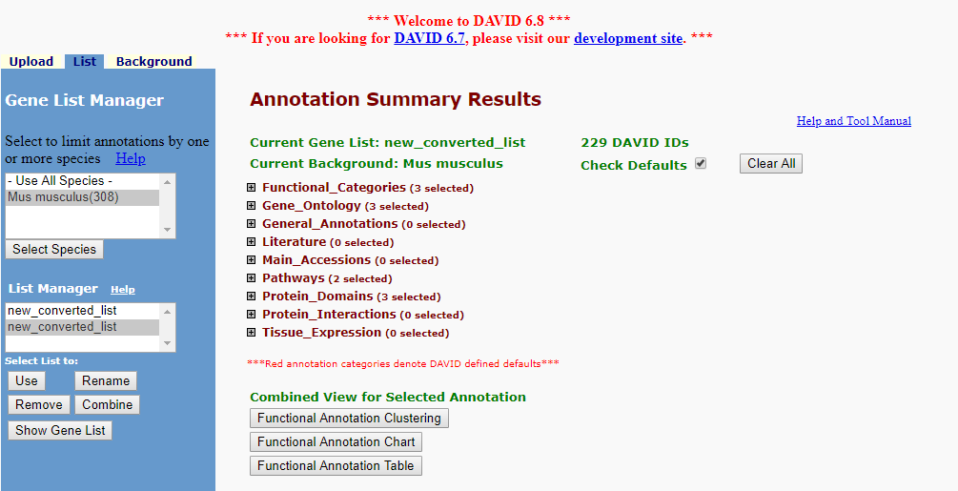
Introduction to Biological Significance

Slide 87
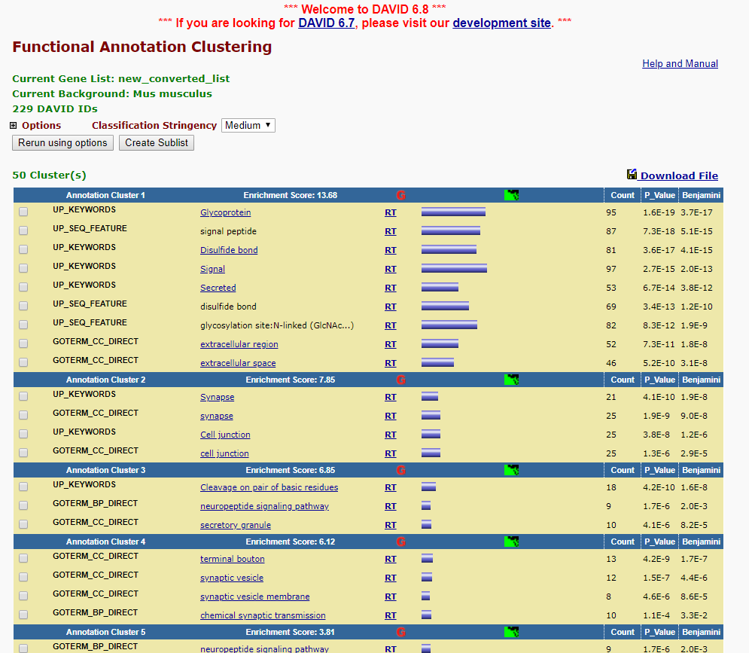
Introduction to Biological Significance

